Slide 1

CLASS COMMITTEE MANAGEMENT SYSTEM
S6 BCA Group: 9
Athulya Anilkumar AM.SC.U3CSC20022
Beena Biju AM.SC.U3CSC20024
Devika Dilip AM.SC.U3CSC20028
Parvathy Vijayan AM.SC.U3CSC20053
Swathy Krishna AM.SC.U3CSC20071
Guided by : ​
Ms. Kavitha K R​
Department of Computer Science​
Amrita School of Computing
Amrita Vishwa Vidyapeetham

Slide 2
INTRODUCTION
This project is designed to conduct class committee meetings and manage its files.
HOD is the admin user of the system who is responsible to add faculties and assign CC-Chairs to each batch under the department.
Advisor/CC-chair manages their assigned batch/group
Group members are HOD, advisors, class instructors/faculties, and student class representatives.

Slide 3
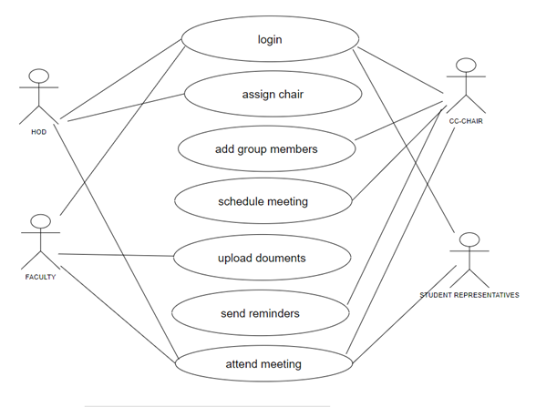
MODULES
Create groups – contains: HOD, CC-chair, instructors, students(reps)
Schedule meetings and Conduct meetings
File management
Marks: graphical representation
Reminders
Mark report generation

Slide 4
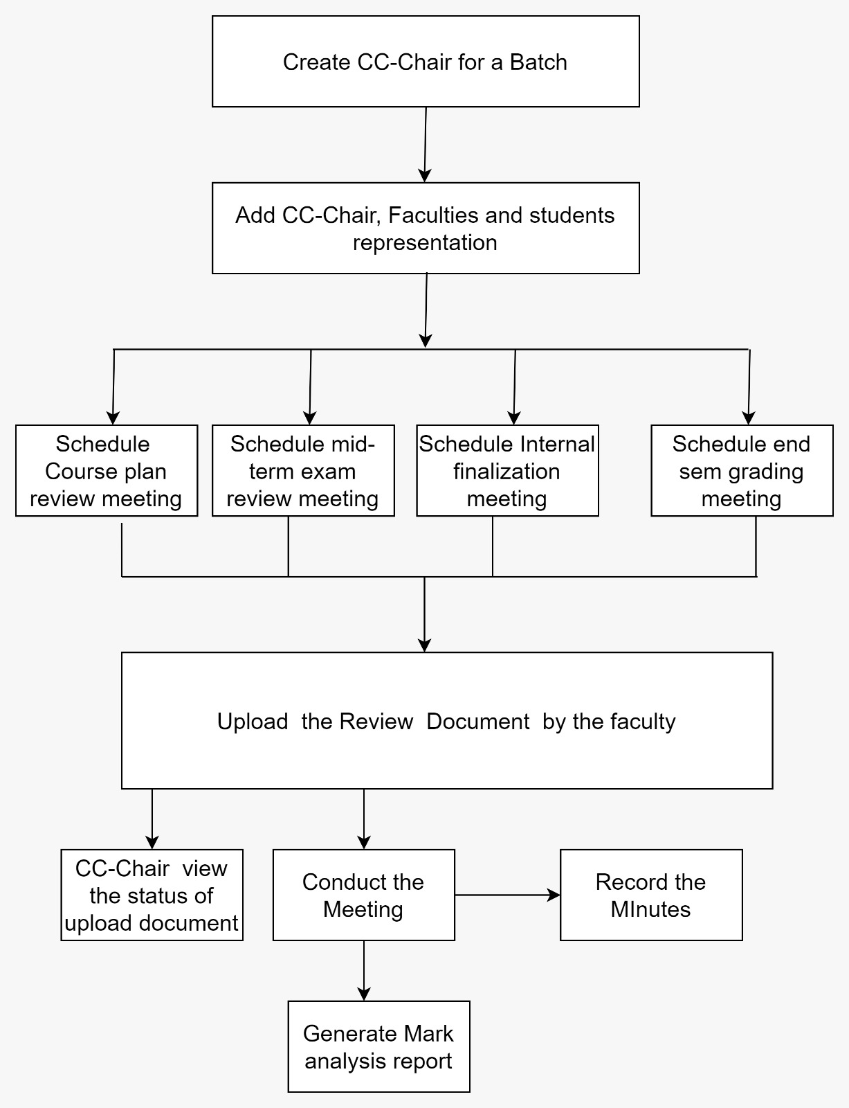
Architecture

Slide 5

FILE MANAGEMENT
BATCH
BATCH & YEAR
COURSE
FACULTY
FILE

Slide 6
Class Performance (Results): Graphical Representation
Extract marks from the mark sheet file
Mark list file must be an excel sheet
Extract all the values in the column
Find average
Convert to graph

Slide 7
Graph and Mark Report
Graph:Convert excel sheet to pie chart with help of google charts.
When faculty uploads the file, number of students, total mark are extracted from excel sheet and stored in table name graph.
To view the result, retrieve the data from graph table based on the users.
Mark report: Extract data from the excel sheet and list students having below 20%, above 90% and absentees.

Slide 8
REMINDERS
Reminders are of two types
Automated
Automated reminders are an efficient and reliable way to prompt individuals to complete tasks or appointments. These reminders automatically generated through mails.
Manual
Manual reminders are customized notifications generated by advisors themselves .

Slide 9
Meetings
Managed by CC-Chair
Conducts meetings which includes class instructors and student representatives.
All the meetings are accessible for HOD.
Can schedule meeting including/excluding students.
Upcoming meetings will be notified.
History of the meetings will be recorded.

Slide 10
HOD
Admin of the system
Hod manages batch, course, groups ,faculty.
Hod assign cc-chair
Can attend all meetings
All files, folders and mark reports are accessible

Slide 11
THANK YOU

